Slide 1
Big data
LONG HUYNH - 984850

Slide 2
Overview

Slide 3
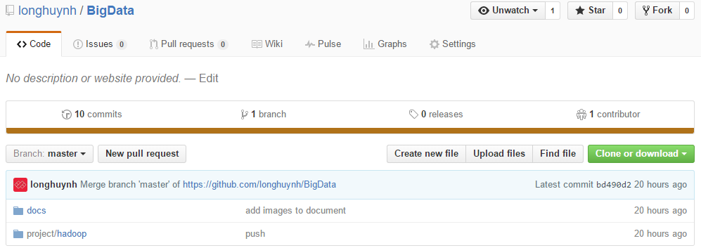
Overview
View more part 1-4
Source code: https://github.com/longhuynh/BigData

Slide 4
Part 5 Spark

Slide 5
Word count
Purpose
Understands Spark as much as I can
Why Word Count?
Keeps everything simple to catch up
Implemented code:
Basic word count algorithm
In 2 ways: Hadoop & Spark
\project\spark\src\main\java\com\spark\wordcount\WordCount.java

Slide 6
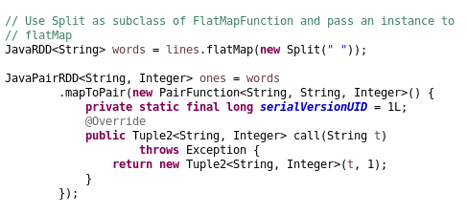
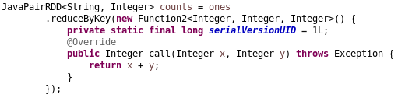
Code implement

Slide 7
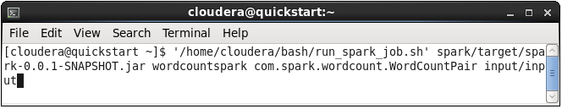
Input & Run on Terminal
Input: /project/input/*
Terminal
input0 | 18 34 56 29 12 34 56 92 29 34 12
input1 | 92 29 18 12 34 79 29 56 12 34 18

Slide 8
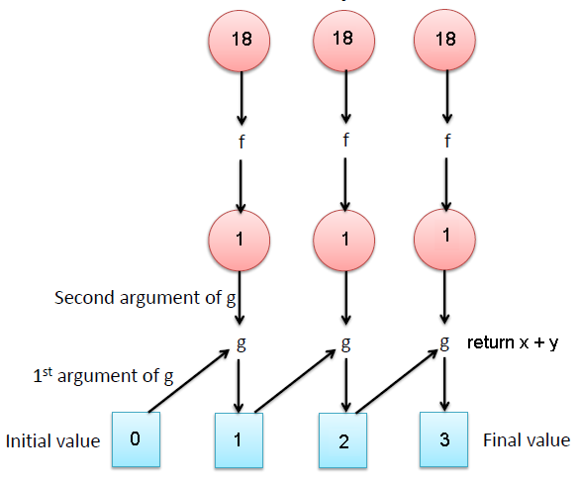
OUTPUT
mapToPair()
18, 1 | 92, 1
34, 1 | 29, 1
56, 1 | 18, 1
29, 1 | 12, 1
12, 1 | 34, 1
34, 1 | 79, 1
56, 1 | 29, 1
92, 1 | 56, 1
29, 1 | 12, 1
34, 1 | 34, 1
12, 1 | 18, 1
79, 1
18, 3
56, 3
92, 2
34, 5
12, 4
29, 4
reduceByKey()
reduceByKey()

Slide 9
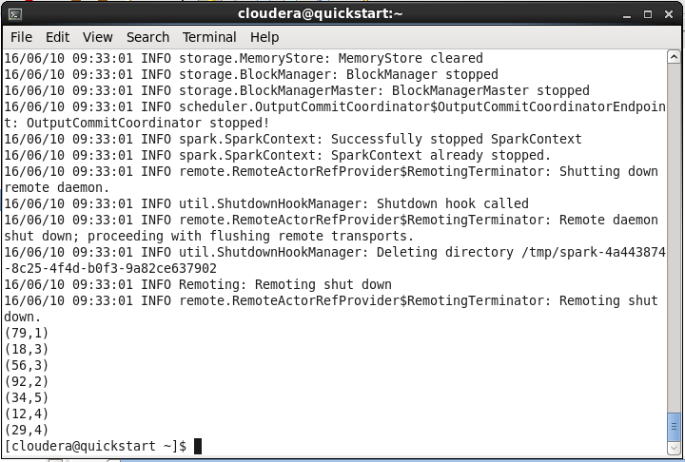
OUTPUT ON Terminal

Slide 10
Part 6 HBase

Slide 11
HBAse Table
Purpose
Understands more about HBase
Using HBase Java API
Feature:
Create table, delete table
Add record, delete record.
Get one/all record(s)
Implemented code
Basic HBase example

Slide 12

Project steps
Creat an HBase Maven Project
Edit file pom.xml config.
Implemented code
Basic HBase example
\project\hbase\src\main\java\com\hbase\table\HBaseTable.java

Slide 13
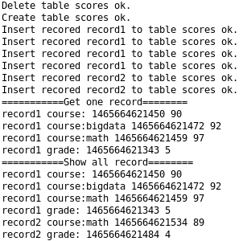
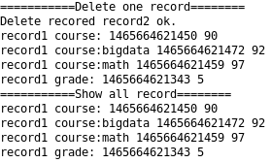
OUTPUT

Slide 14
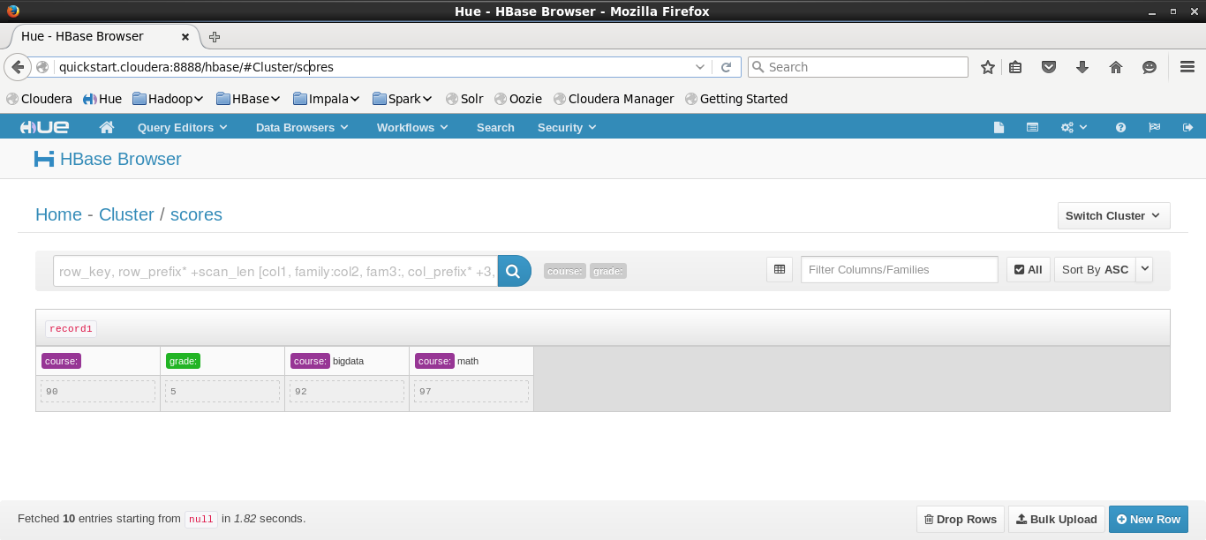
Using UI to Manage
Default username/password: cloudera/ cloudera

Slide 15
Part 9 Optional Project

Slide 16
Pseudo code
class Mapper
method Map(docid a, doc d)
for all row in doc d do
array = SPLIT(row)
firstName = array[0]
H = new AssociativeArray
for all term u in array[1] do
H{u} <-- 1 // Check exist
Emit(term w, stripe H)
class Reducer
method Reduce(term w, stripes [H1, H2,...])
Hf = new AssociativeArray
marginal = 0
for all stripe H in stripes [H1, H2, ...] do
Hf = INTERSECT(H, Hf)
Emit(term w, stripe Hf)

Slide 17
Implement code
Implement Java code:
\project\optional\src\main\java\com\hadoop\jobs CustomerDriver.java
\project\optional\src\main\java\com\hadoop\mappers\CustomerMapper.java
\project\optional\src\main\java\com\hadoop\reducers\CustomerReducer.java

Slide 18
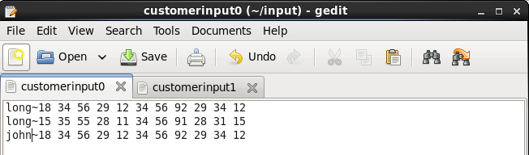
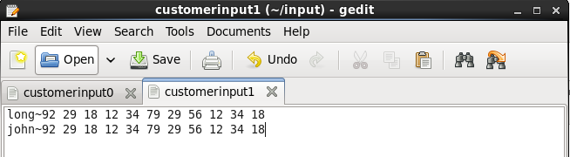
Input
Input: /project/input/customerinput*

Slide 19
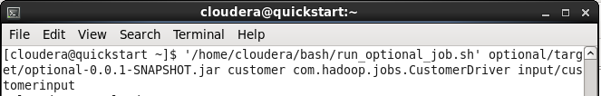
Command line
\bash\run_optional_job.sh

Slide 20
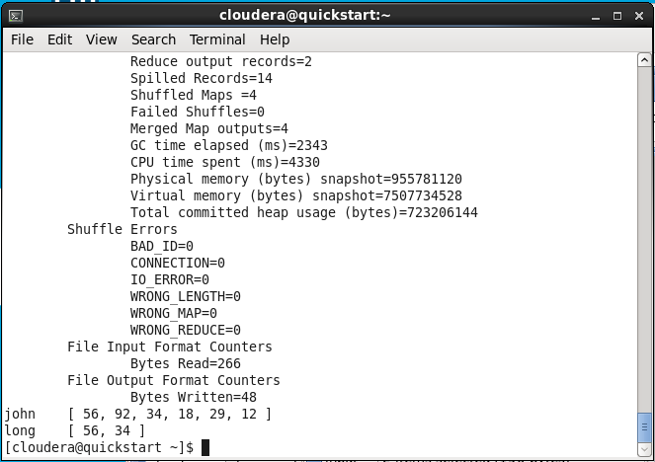
Terminal Output

